Slide 1





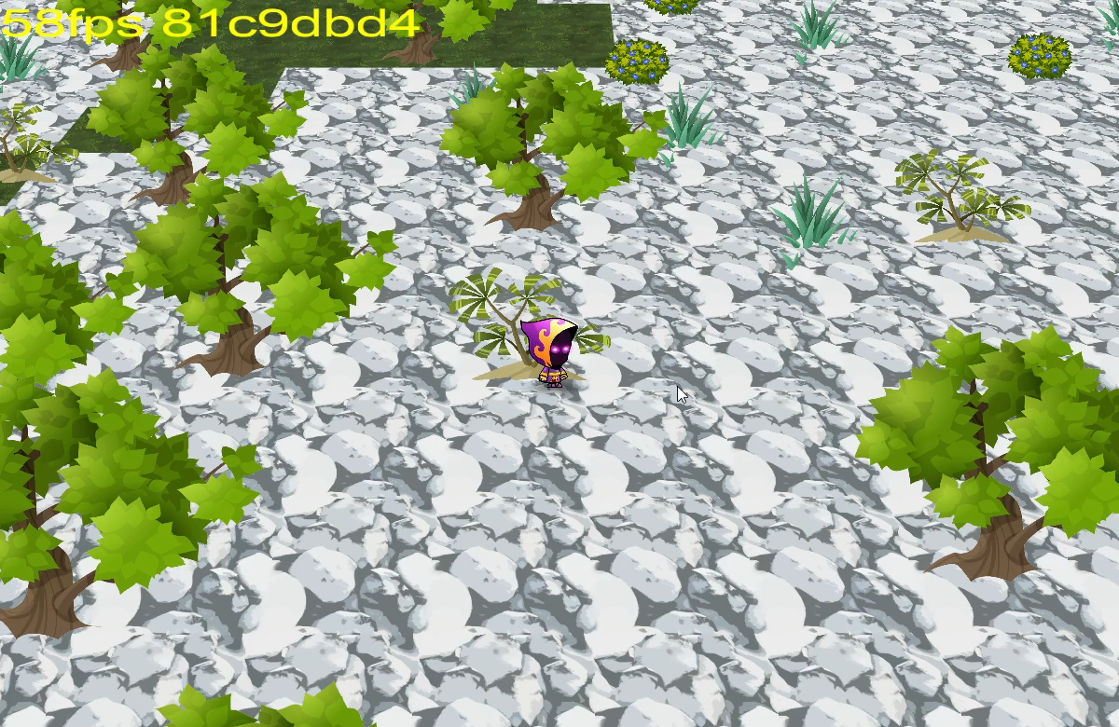
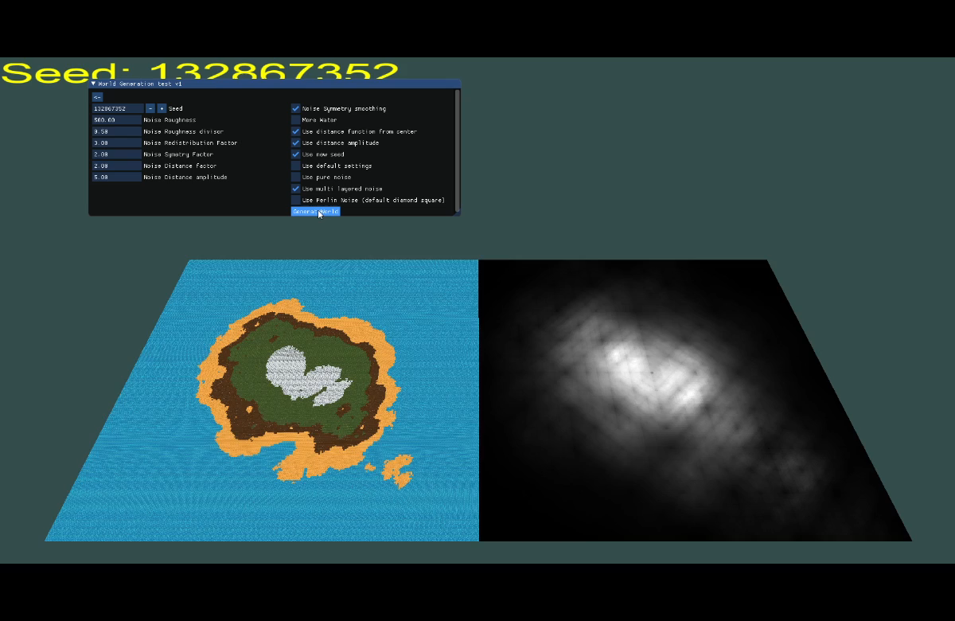
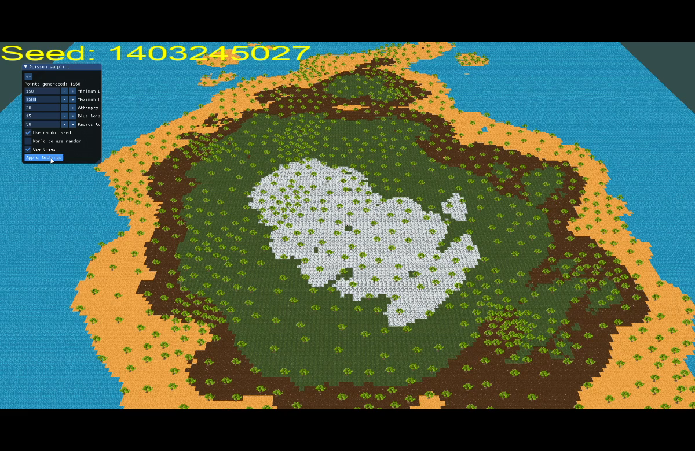
2.5D Tile based game with Procedurally Generated Content and engine
Michael Allport, Dr Michael Fairbank (Supervisor)
Tailored engine consisting of:
Low Level OpenGL Rendering pipeline
Font rendering
GLSL Shader programs
Input event subsystem
Texture caching
Logging subsystem
Window context creation
Orthographic & Perspective camera projection with ability to extend to custom projections
Developed in C++
Game features:
3D perspective floor projection
2D sprite objects
Ray plane intersection to attain mouse to world coordinates
Object ID encoding to attain object under mouse from exact texture shape
Highlighted objects for user awareness
Procedurally generated world and vegetation
Gameplay
Procedurally generated world content using:
Terrain
- Diamond Square noise algorithm to generate 2d heightmaps associated to terrain types
- Many adjustable parameters for noise manipulation
Vegetation
- Poisson disc placement with Perlin Noise to guide density of trees and shrubs
All generation is seeded to provide reproducible results to the user
World generation
Vegetation/Tree placement

